Slide 1
Integrated Math 2 Unit 4 Toolkit (learning targets)
Reminder: keep all notes in a safe place!! They may be used on group quizzes and both final exams. These notes are a study tool to help you prepare for each unit test.

Slide 2
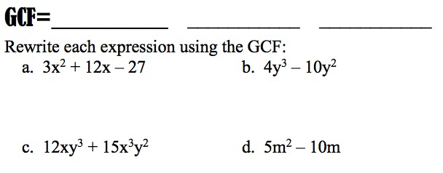
Tool-Kit

Slide 3
Tool-Kit

Slide 4
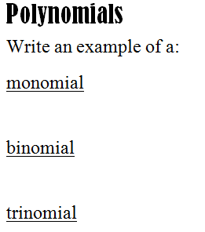
Tool-Kit

